Slide 1
Xamarin for Mobile App Development
Billy Cox
billy.cox@zsquared.net

Slide 2

Agenda
App for VITA SA
Development
Good, bad, ugly

Slide 3
VITA (vitasa.org)
Volunteer Income Tax Assistance
IRS program, assist with income tax prep
For AGI < $60k
For eFilers, certification required (online IRS test)
In SAT last year
~58k returns, ~$60M EITC, 300 volunteers (eFilers), 19 sites
Managed by San Antonio VITA Coalition
~60% funding from COSA, 40% from United Way
Issue: some sites had too many eFilers, some sites had none
App: guide volunteers to sites that need help

Slide 4
Requirements (gathered from Coalition)
Phone only, no tablet
iOS and Android (web added later)
Allow volunteers to find sites and signup
Allow Site Coordinators to manage their site details (open days, times, etc.)
Provide means for volunteer feedback

Slide 5
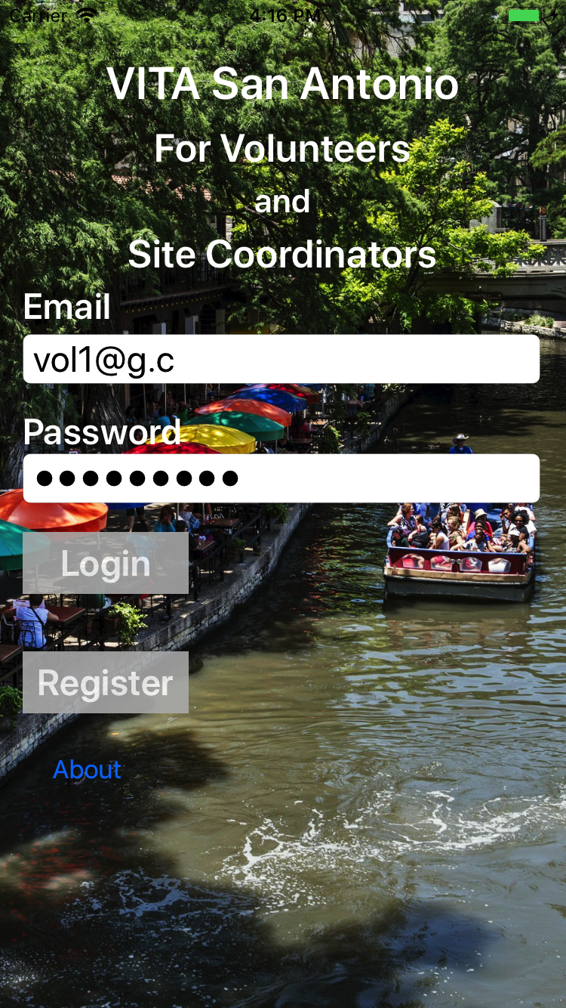
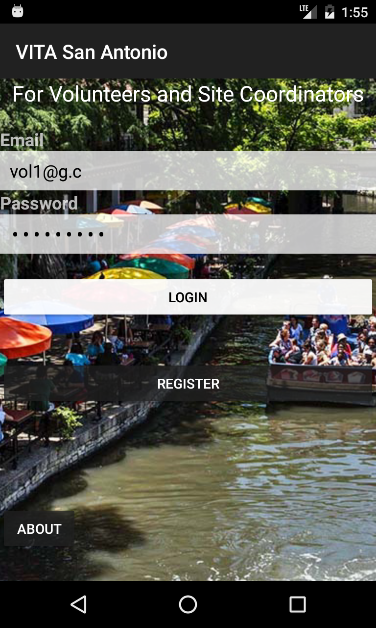
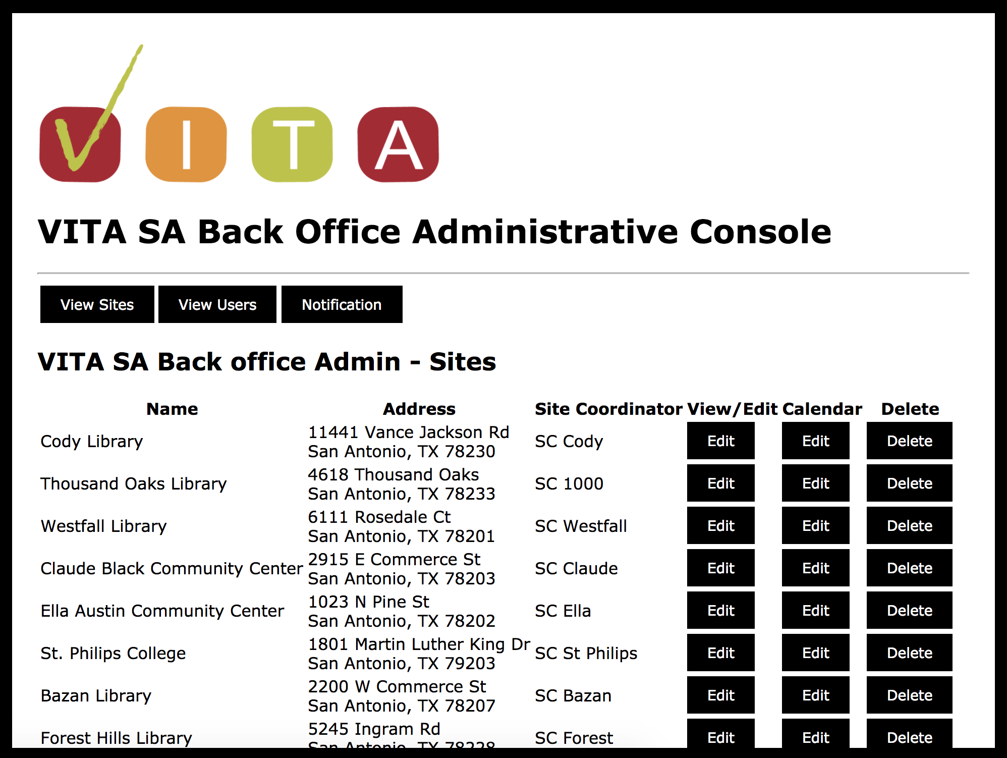
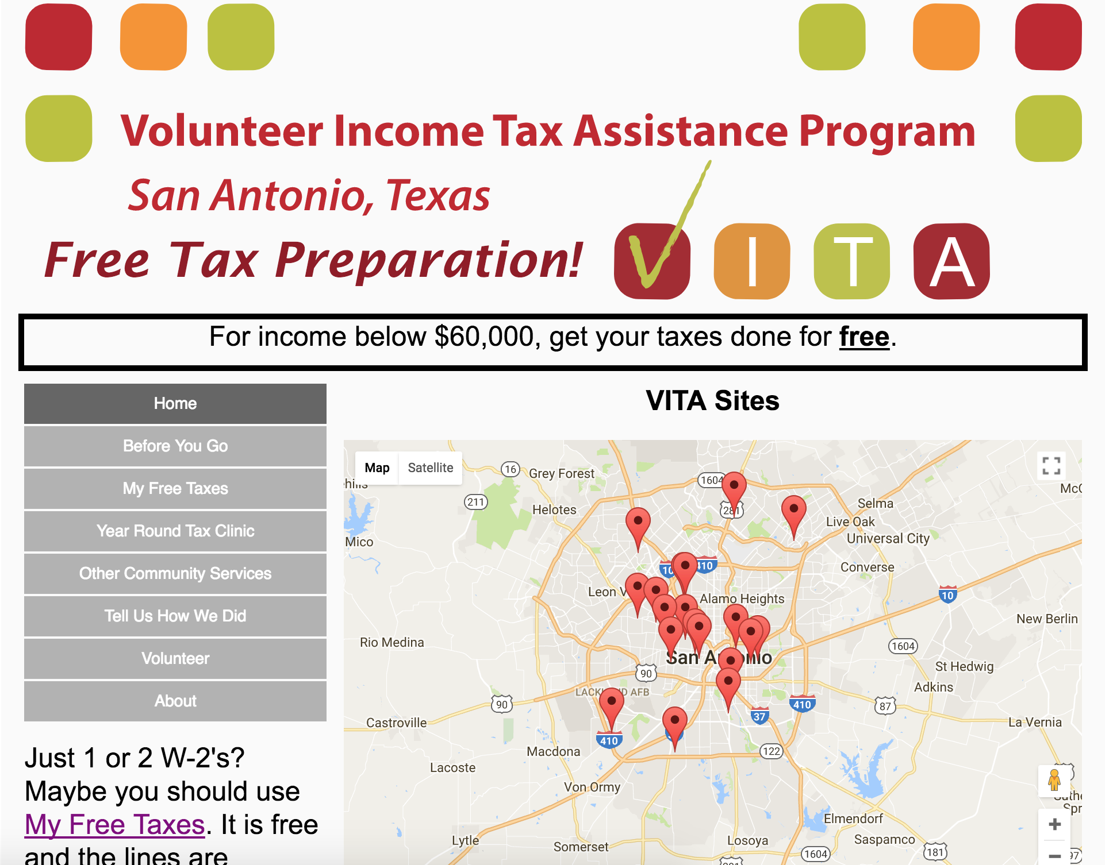
VITA SA App High Level
BackEnd
DB
Linux/Ruby
MySQL
iOS Devices
All connections are https
Android Devices
vitasa.org
(English and Spanish)
WordPress
Back office administration
Client web and mobile

Slide 6
Mobile App: Lot of screens
Web version is similar
Main
VolunteerOptions
MySignUps
ViewSignUpExisting
ViewController
VolunteerOptions
MySignUps
iOS
A_ViewSignUpExisting
VolCalendar
VolPickSite
VolPickShift
ViewSignUpNew
Calendar
SitesOnDateList
VolPickShifts
SignUp
About
About
Suggestions
Suggestion
VolPickSiteMap
Suggestions
Suggestion
SitesOnDateMap
Registration
Profile
Register
UpdateProfile
Volunteers
SCMySites
Site Coordinators
SCSites
SCSiteVolCalendar
SCSiteShifts
SCSiteVol
SCVolHours
SCSiteVolCalendar
SiteShifts
SCVolunteers
SCVolunteerHours
SCSite
SCSite
SCCalendar
SCSiteCalShifts
SCShiftDetails
SCSiteCalendar
SCSiteOnDate
ShiftDetails
1.0

Slide 7
Basic App Design
iOS Library
Screens
Code behind
Certificates
iOS
Apple Service handlers
Common UI classes
Simple tools
Backend
Shared Library
DB
All calls to the cloud backend
Common app logic
Caching support
Screens
Code behind
Certificates
Android
Android Library
Google Service handlers
Common UI classes
Simple tools

Slide 8
Development Options
Swift and Java
Would have had to the entire code the app twice (Swift and Java)
Swift is not stable and lacks ObjC coverage
Swift exposes the same bizarre ObjC constructs (ex: string)
Javascript
Language not ready (my biased opinion)
Docs always seem to skip the release and distribution phase
Xamarin (C#) using Visual Studio Community edition
Already well versed in C#
Code actually ran identical on both platforms (!)
iOS: Uses xcode on the backend
Android: Uses Google (and Intel) emulators (failed)
Screen size testing
iOS: based on the device
Android: spec’d when building the emulator
Debugger support is excellent
My son developed the backend services
Started on AWS Lambda, migrated to Ruby to shorten development cycle

Slide 9
Xamarin
Company (now) owned by Microsoft (post Balmer)
Founded 2011 to create Mono
Based on Visual Studio
Claimed could use Windows to build iOS and Android (Android: yes, iOS: never made it work)
In the end: ran Visual Studio and Xamarin on MAC
Claim 75% of code can be common (maybe)
Claim common UI (not that I could find)
Very thorough ObjC support (and docs)

Slide 10
Good
Xamarin actually worked! End to end.
C# libraries just worked
Nearly all ObjC calls supported in Xamarin (far better than Swift)
All OS related calls worked across iOS and Android without exception (especially good given the heavy use of the network APIs)
Heavy use of ‘await’ worked flawlessly (hid threading complexity)
StackOverflow was an excellent and necessary resource (Xamarin folks appears to watch and respond)
Google UI design (layout) is excellent, and finicky, and docs are weak (yea StackOverflow)

Slide 11
No So Good - 1
Can’t update a library without updating everything (compiler, other libraries, etc.)
Have to implement the UI twice – semantics are different enough to be a pain
iOS: Plan to spend HOURS on the UI to get the dependencies just right (for different screen sizes)(massive over complexity) [screenshot]
Had to go SLOW at times to keep from getting the xcode designer confused
Android emulator failed; had to resort to a physical device; poor screen size testing
Some users reluctant to install an app (!); drove web implementation
Significant concerns over privacy

Slide 12
No So Good - 2
Apple
App signing certificates (multiple) are a confusing mess
Submissions are fickle (rejections can be invalidated with an appeal)
Enterprise vs public
Must implement iPad version even if iPhone only
Google
Trivial process but hung up on a URL in my help screen; they wanted proof I owned that domain
Having user/name password created concerns
Privacy
Users CANNOT remember their passwords!
Backend outages were painful
Eventually migrated to DreamHost

Slide 13
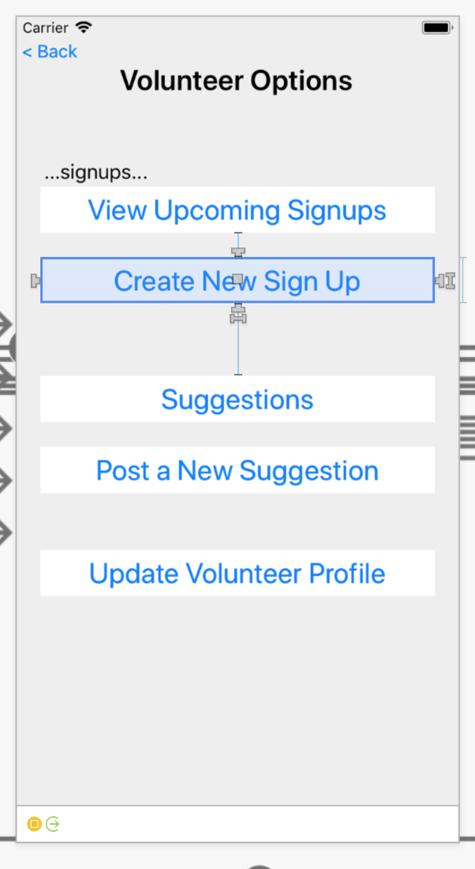
Constraint Editing Mode

Slide 14
Ugly
iOS UI designer would corrupt it’s own xml file occasionally! Kept frequent backups
iOS: Page transitions are connected and named manually in Visual Studio/Xcode UI and then must get the name exactly right in the code [screenshot]

Slide 15
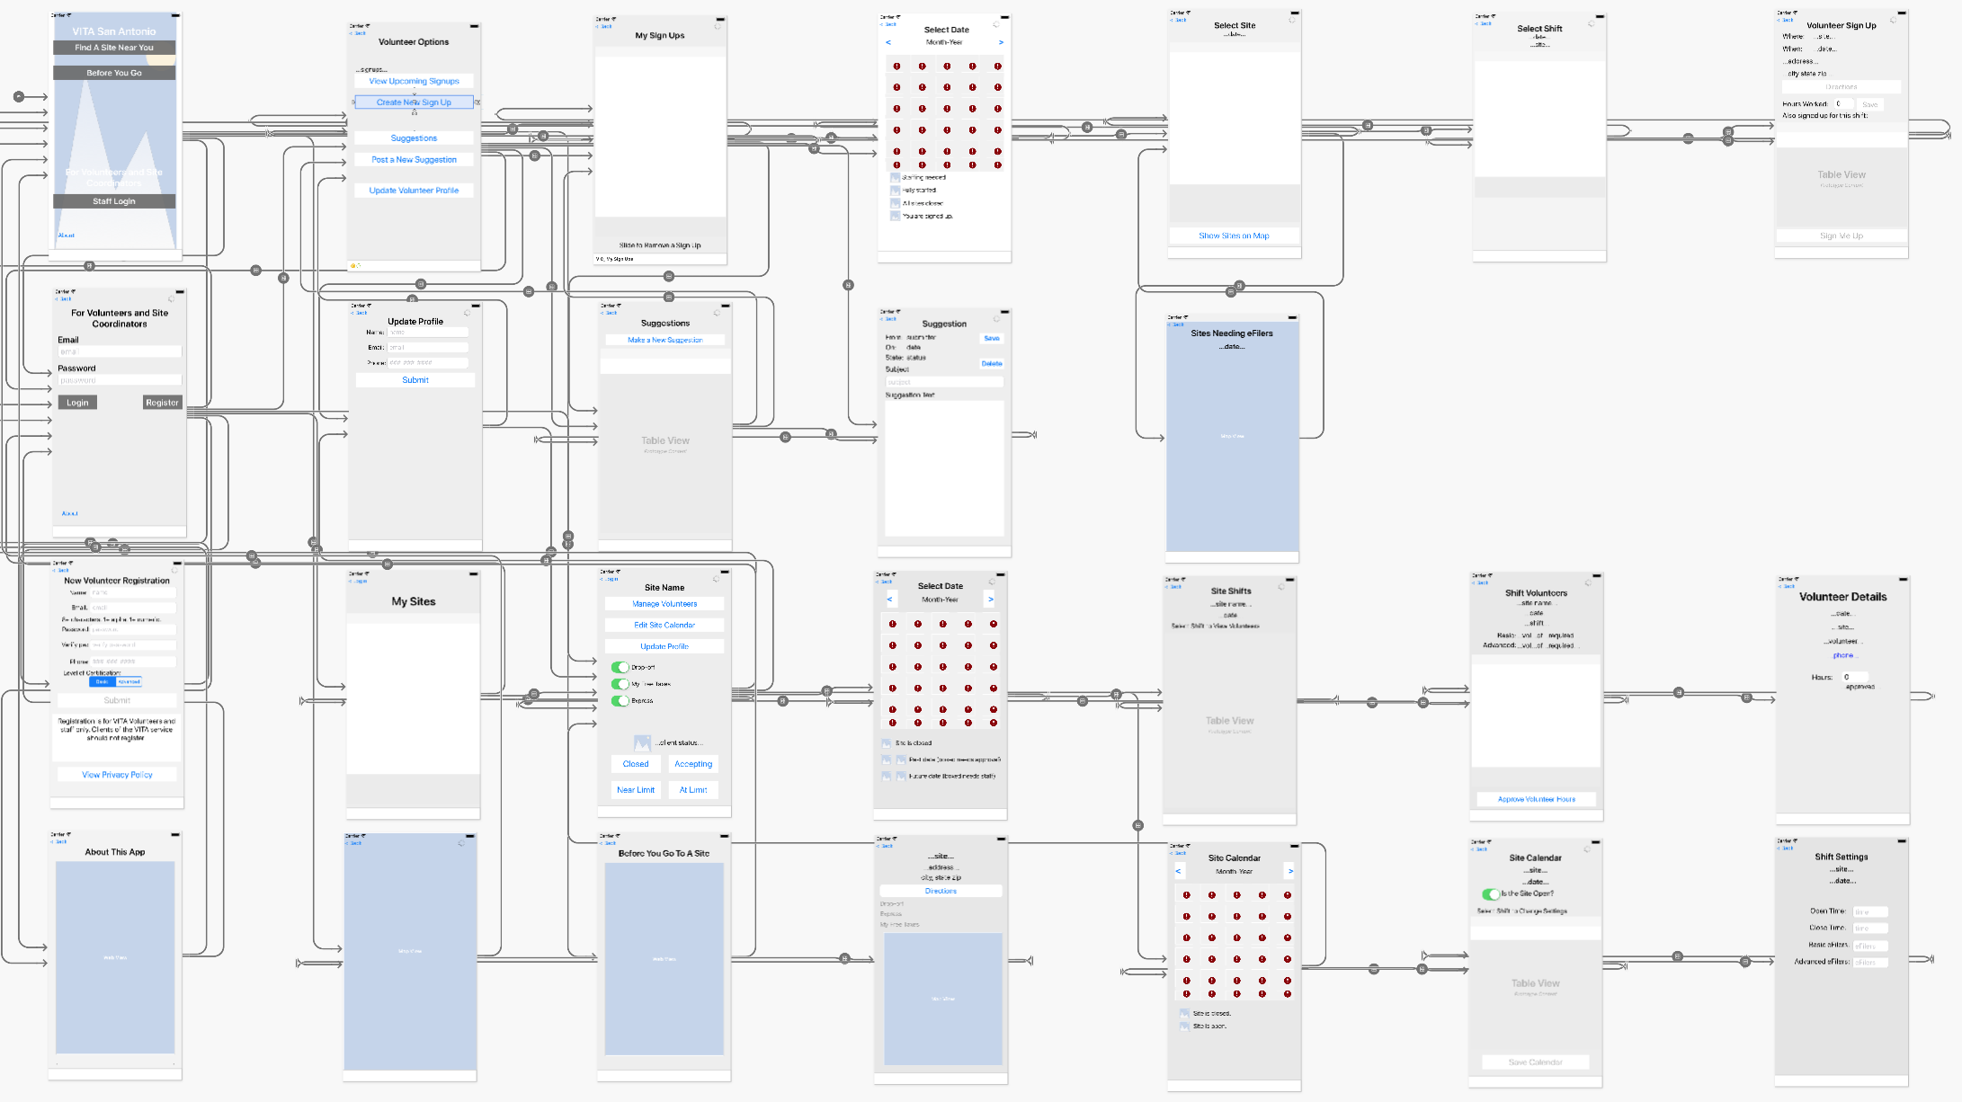
Manually Set Page Transitions!

Slide 16
A Word on Releases
Apple AppStore
Claimed 10 days, usually 2-3 days
Different reviewers enforce rules differently
Building the package took numerous attempts to find the right combination of certificates (poor docs)
Allocate most of a week just to get into the store for review
Google Play
Effectively no review at all (automated scan)
Hours from submittal to response (and a few more hours until available in the store)

Slide 17
Questions?

